Slide 1




Flutter – Lecture 2

Slide 2
Topics to be Covered
We will Cover :
First App Tree
Flutter Project Folder Structure & Description

Slide 3
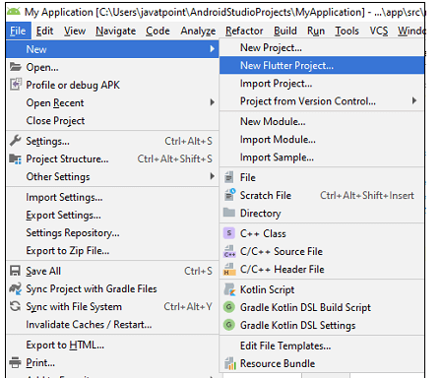
Creating Your First App
New project can be created using Android Studio or VS Code.
Here, we are using Android Studio!
Open the Android Studio.
go to File-> New->New Flutter Project.

Slide 4
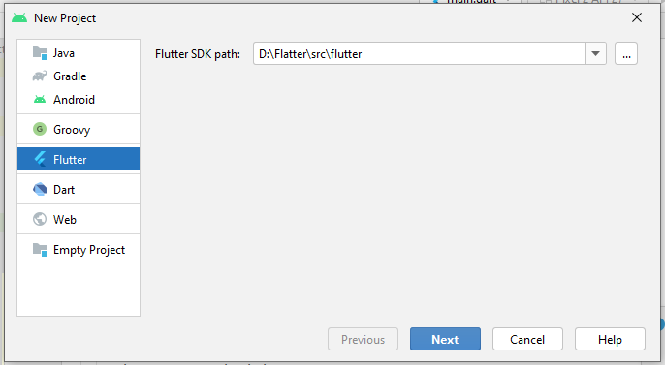
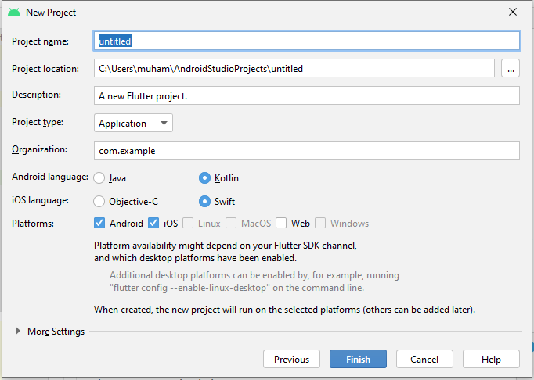
Create Your First App cont…
Provide Flutter SDK path
Write the
Project Name
Project Location
Description
Project Type

Slide 5
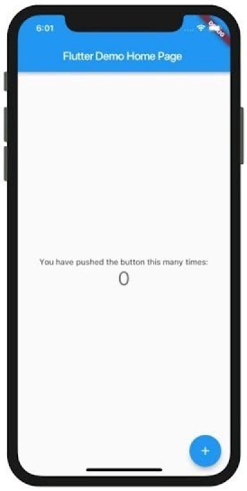
Your First App
When the project is created, you will get a fully working Flutter application with minimal functionality.
You also need an emulator to display output
import 'package:flutter/material.dart'; void main() { runApp(const MyApp()); } class MyApp extends StatelessWidget { const MyApp({Key? key}) : super(key: key); @override Widget build(BuildContext context) { return MaterialApp( title: 'Flutter Demo', theme: ThemeData( primarySwatch: Colors.blue, ), home: const MyHomePage(title: 'Flutter Demo Home Page'), ); }
} class MyHomePage extends StatefulWidget { const MyHomePage({Key? key, required this.title}) : super(key: key); final String title; @override State<MyHomePage> createState() => _MyHomePageState(); } class _MyHomePageState extends State<MyHomePage> {………}
Notes:
Create a simple, templated Flutter app. Create a Flutter project called startup_namer as follows.
Replace the contents of lib/main. dart . ...
Run the app. You should see either Android, iOS, Windows, Linux, macOS, or web output, depending on your device.
Observations.

Slide 6
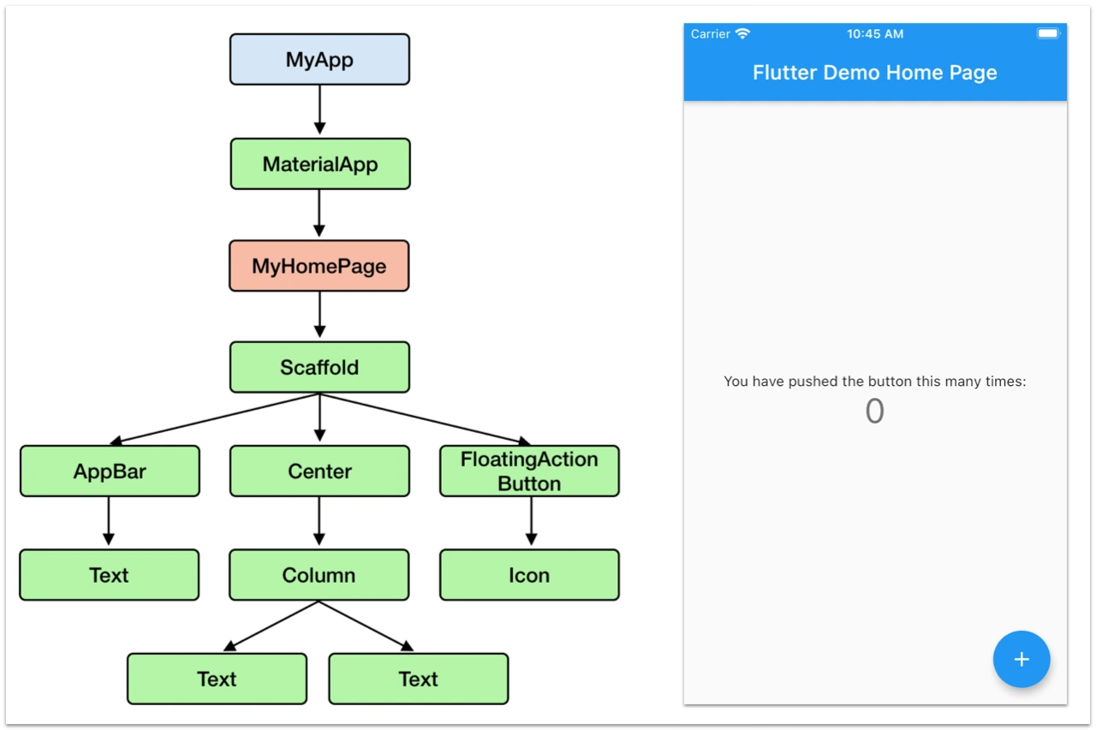
Application widgets Tree
Notes:
Flutter widgets are built using a modern framework that takes inspiration from React. The central idea is that you build your UI out of widgets. Widgets describe what their view should look like given their current configuration and state. When a widget’s state changes, the widget rebuilds its description, which the framework diffs against the previous description in order to determine the minimal changes needed in the underlying render tree to transition from one state to the next.

Slide 7
Description of Code
Main.dart file is the entry point of the Flutter application. Calls runApp function and pass it an object of MyApp class. The purpose of the runApp function is to attach the given widget to the screen.
import the flutter package, material. The material is a flutter package to create user interface according to the Material design guidelines specified by Android.
StatelessWidget is a widget, which does not maintain any state of the widget. MyApp extends StatelessWidget and overrides its build method.
The build method gets the context environment necessary to build the widgets through BuildContext parameter and returns the widget it builds.
In the code, we have used title as one of the constructor argument and also used Key as another argument. The title is used to display the title and Key is used to identify the widget in the build environment.
The build method calls the build method of Scaffold, which in turn calls the build method of AppBar and Center to build its user interface. Finally, Center build method calls Text build method

Slide 8
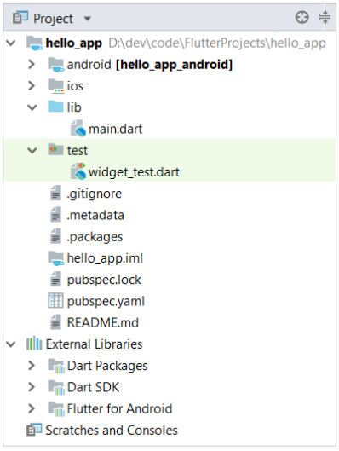
Flutter Project Files and Folders
Flutter projects consist some files and folders as shown:-
Notes:
After creating a new flutter project in Android studio, the flutter framework automatically generates some files and folders by default. Introduction to all these files and folders. So newly generated files look something like this as shown in figure:

Slide 9
Description of default files and folders
Various components of the structure of the application are explained here:
android - Auto generated source code to create android application
ios - Auto generated source code to create ios application
lib - Main folder containing Dart code written using flutter framework
lib/main.dart - Entry point of the Flutter application
test - Folder containing Dart code to test the flutter application
test/widget_test.dart - Sample code
.gitignore - Git version control file
.metadata - auto generated by the flutter tools
.packages - auto generated to track the flutter packages
.iml - project file used by Android studio
pubspec.yaml - Used by Pub, Flutter package manager
pubspec.lock - Auto generated by the Flutter package manager.
README.md - Project description file written in Markdown format

Slide 10
Summary
Today we have learned about:
Creating Your First App
Application widgets Tree
Description of Code
Flutter Project Files and Folders
Description of default files and folders

Slide 11
In Next Lecture:
We will Cover:
Dart Basic
Dart Main() fun
Dart Type System
Dart Variables

